Slide 1
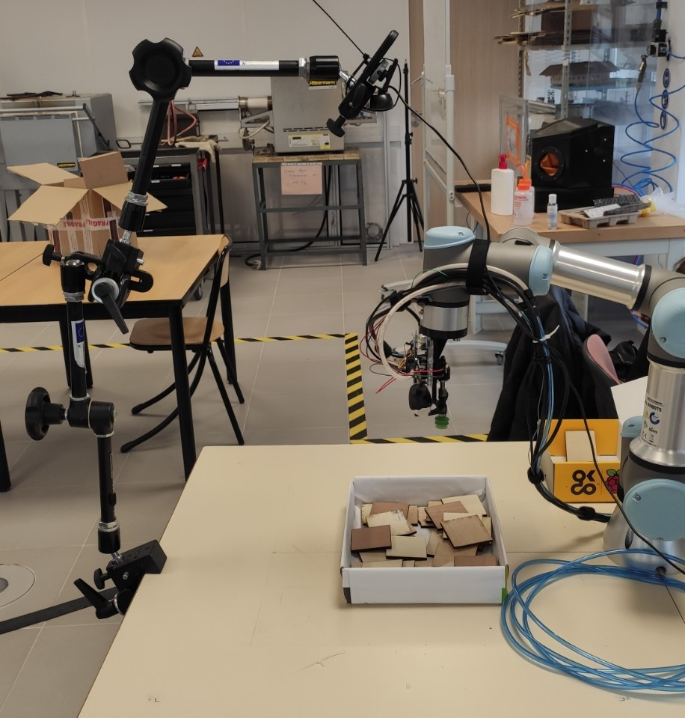

SM3
CP1
SM1-2
EN2
CP2
EN1

Slide 2
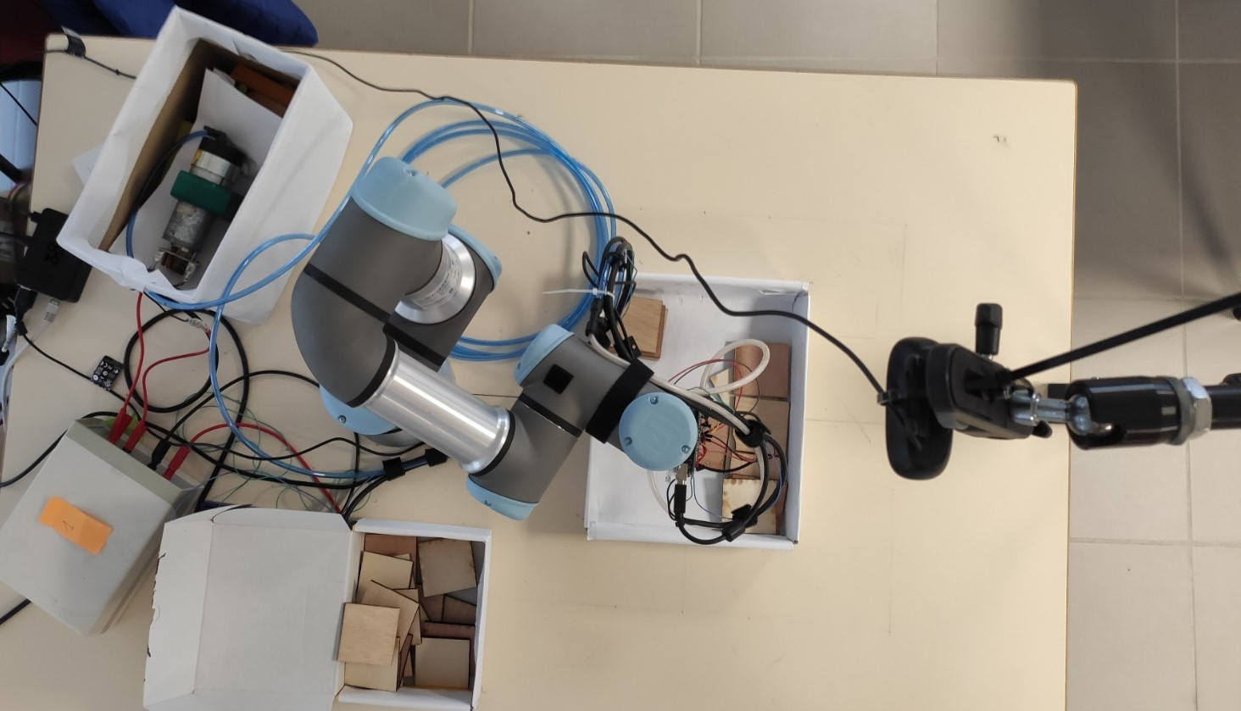
SM4
EN2
CP3
SM5
SM3
EN1

